Slide 1
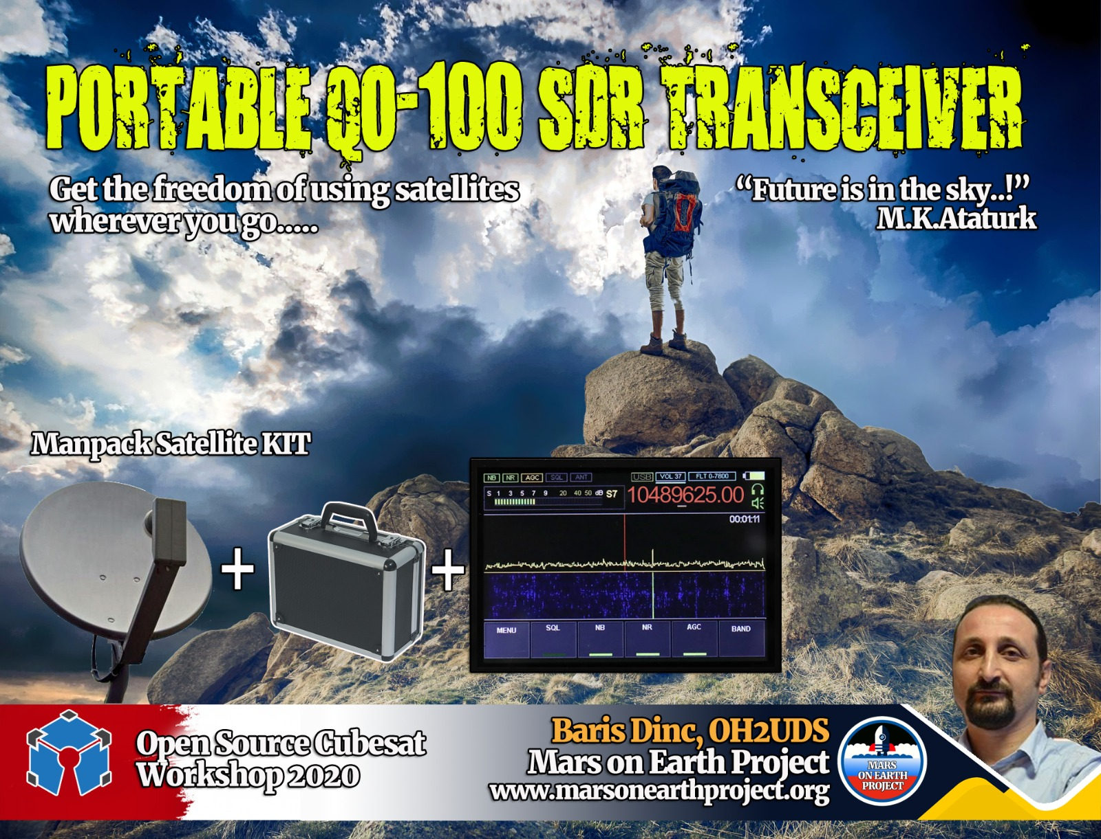

Slide 2
THE STORY
HighPower
Durable
Ultra Reliable
Ultra Stable
OPENSOURCE
SDR V/UHF Transceiver
Satellite comms
moonbounce
cubesats
moonbounce
Meteor scatter

Slide 3
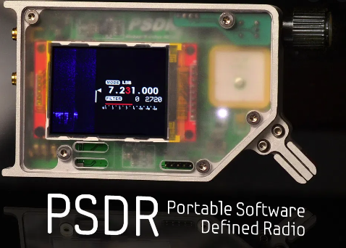
THE STORY
RESEARCHES

Slide 4
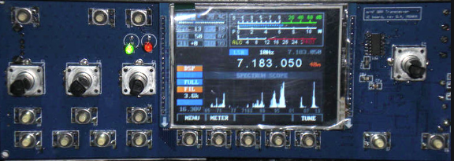
THE STORY
M0NKA mcHF

Slide 5
THE STORY
M0NKA mcHF
STM32
Source Available
Simple (!) Hardware
Good Performance

Slide 6
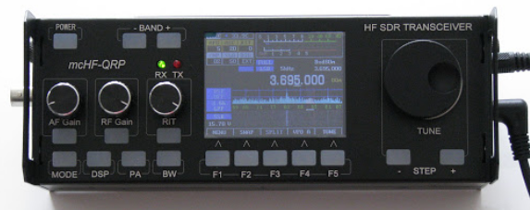
THE STORY

Slide 7
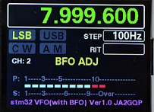
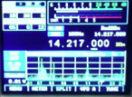
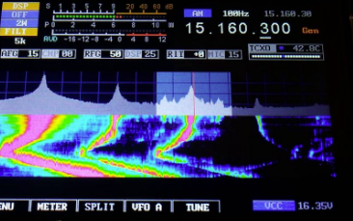
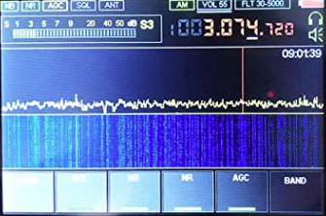
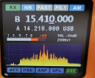
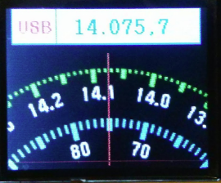
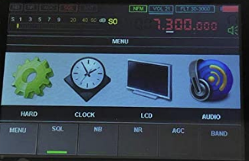
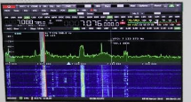
THE STORY

Slide 8
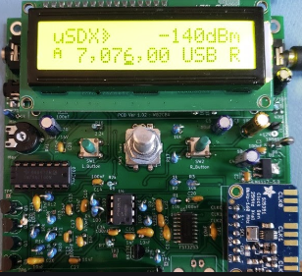

THE STORY
Arduino (Atmel 328p) MCU
Very Simple Hardware
Compact Design
TNX
PE1NZZ Guido

Slide 9

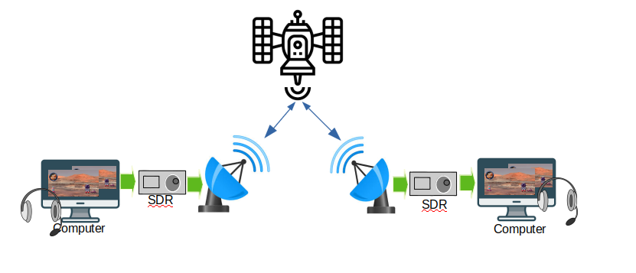
THE PROJECT
OPENSOURCE
QO-100 Transceiver

Slide 10
THE PROJECT
Learn details of “Software Defined Radio”
Should be portable, preferably ManPACK
Should be as CHEAP as possible
Should be very simple
Should be expandable (HW&SW)
Should be battery powered
Should be STABLE
OPEN SOURCE, COLLABORATIVE, NON-PROFIT

Slide 11
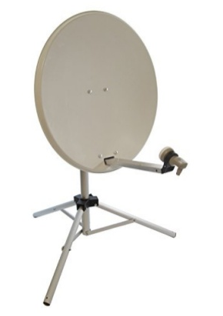
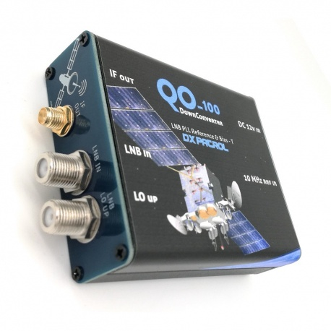
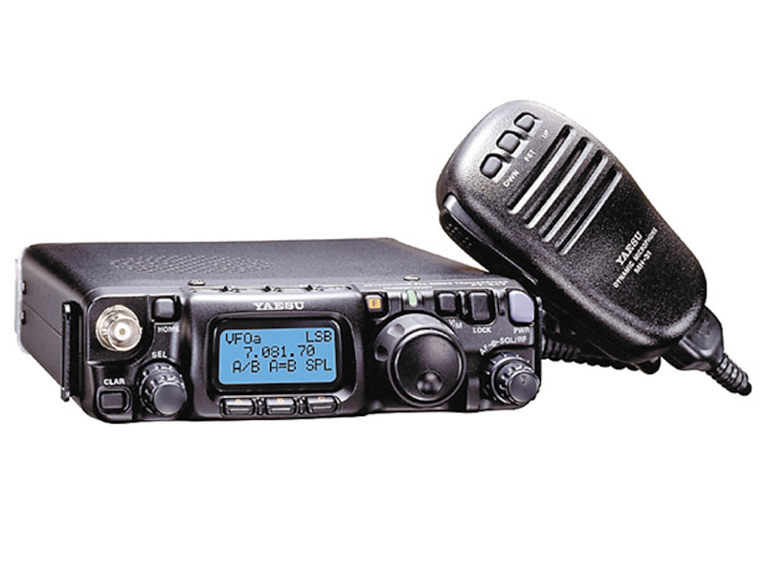
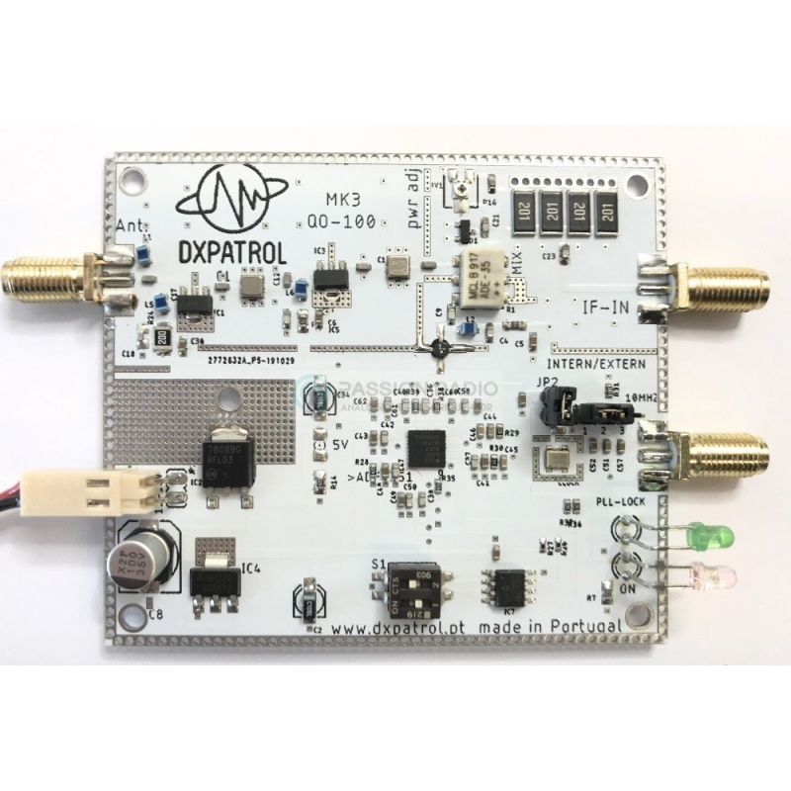
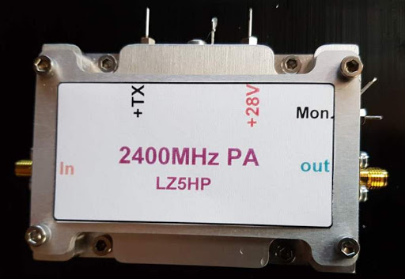
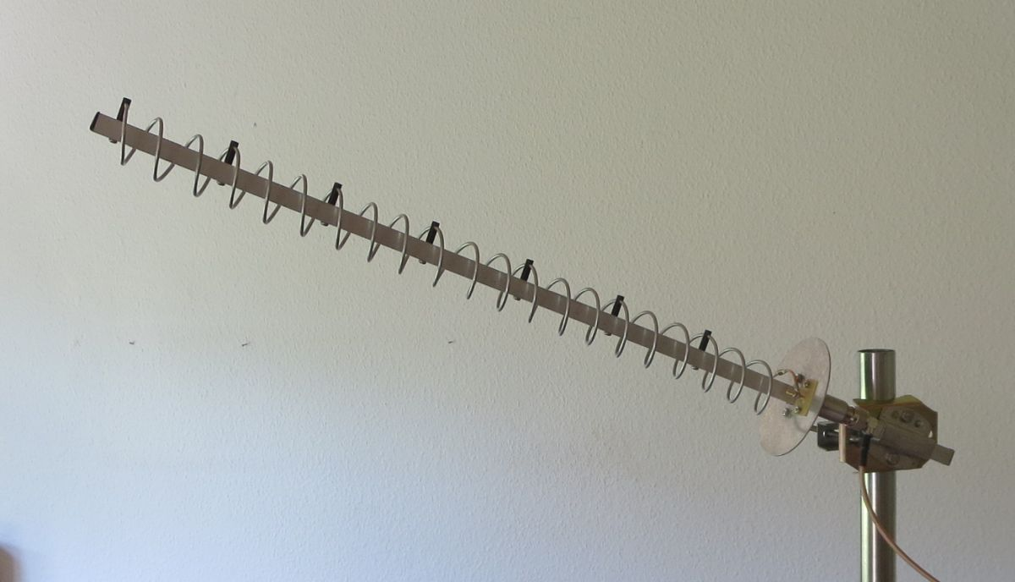
COMMERCIAL SETUP
10GHz 739 MHz
144 or 28 MHz
Dish+LNB
IF SSB Radio
Down Converter
2.4 GHz Antenna
Power Amplifier
Up Converter
A Commercial QO-100 Satellite Setup

Slide 12
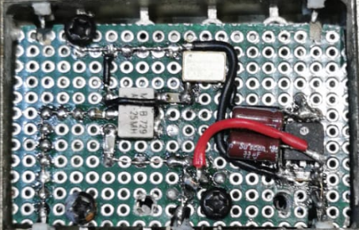
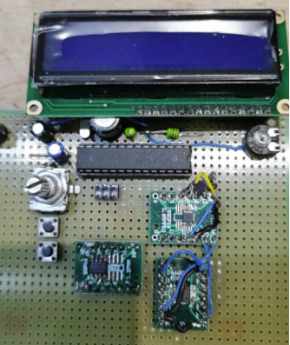
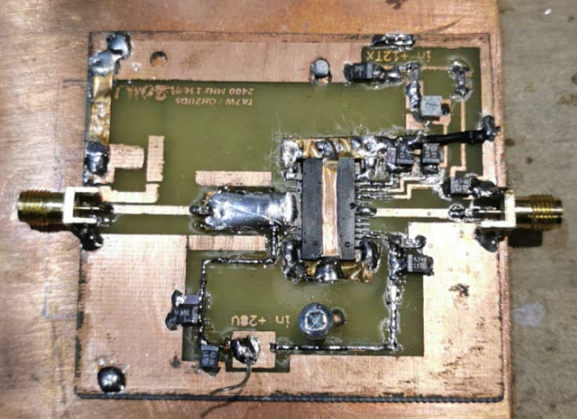
SOLUTION OVERVIEW
10GHz 739 MHz
IF SSB Radio X2
144 or 28 MHz
Dish+LNB
Down Converter
2.4 GHz Antenna
Power Amplifier
Up Converter
Our QO-100 Satellite Setup

Slide 13
SOLUTION OVERVIEW
10GHz 739 MHz
IF SSB Radio X2
144 or 28 MHz
Dish+LNB
Down Converter
2.4 GHz Antenna
Power Amplifier
Up Converter
Our QO-100 Satellite Setup

Slide 14
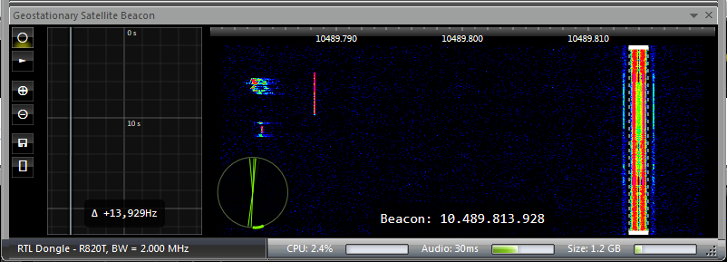
FREQ. STABILITY
SDR Console GEO Satellite Beacon Follower
Similar capability will be achieved using an independent secondary IF receiver

Slide 15
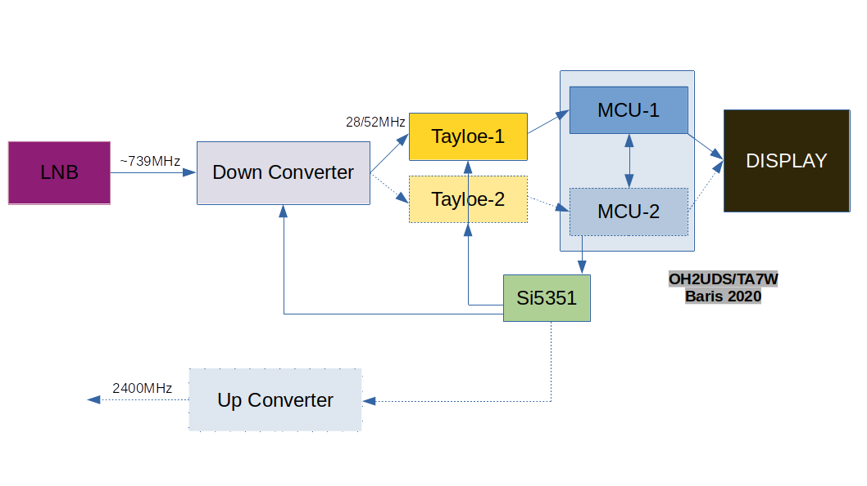
SOLUTION OVERVIEW

Slide 16
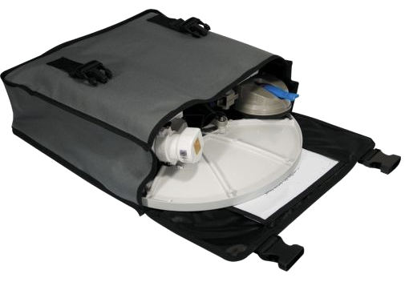
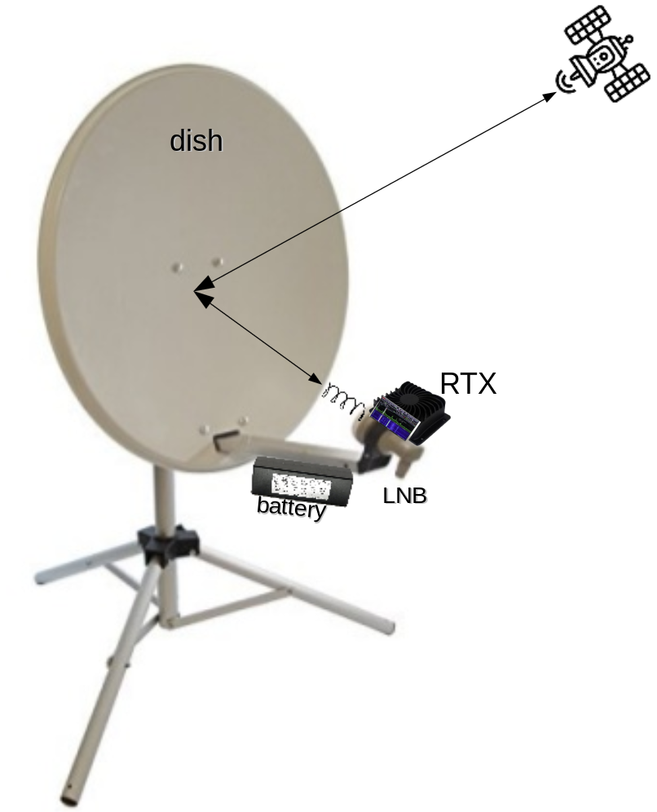

THE GOAL
Fits in a BackPack
Specification
10 GHz Downlink
2.4 GHz Uplink
1-10 Watts RF Power
10 Hz steps
50 MHz IF
CW/AM/SSB Modulation
FT8, SSTV, KG-STV…
~5Kg
Headset
Eveything in picture in less than 100 Euros budget

Slide 17
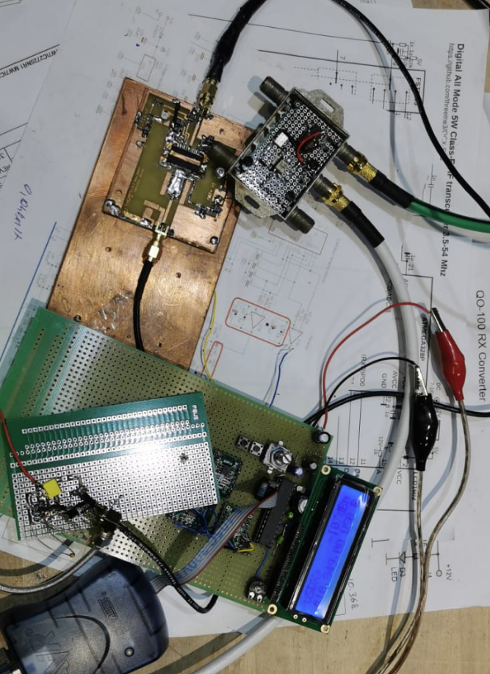
PROJECT STATE
EARLY PROTOTYPE PHASE – BENCH TESTING

Slide 18
WHAT’S NEXT ?
WHAT ARE WE LOOKING FOR ?
Contributors of any kind to make the project alive
Arduino or Embedded C/C++ Developers
PCB designers
Makers/Builder to build and test the HW/SW
Testers/Users for experience feedback
Mechanical designers for achieving the best
“We have tasks for everybody to collaborate”

Slide 19

“OPENSOURCE” does not mean sharing something that you don’t need anymore...
“OPENSOURCE” is to start sharing at the beginning and allowing everybody to “collaborate”…
baris@marsonearthproject.org
https://www.marsonearthproject.org
https://github.com/barisdinc/QO100-Portable

